Slide 1

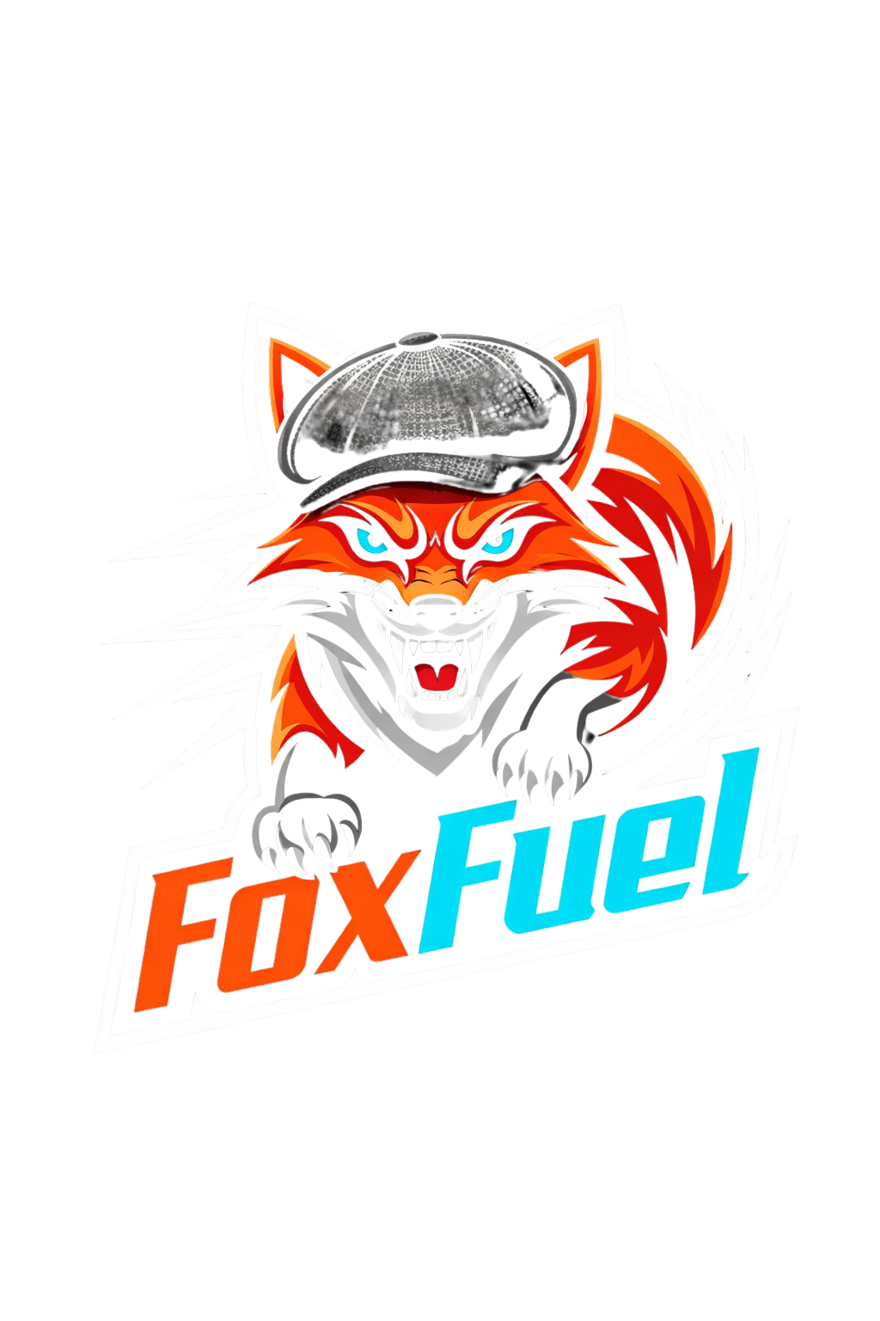
FoxFuel Beverage Co.
The first drink for business.
PRESENTED BY LUCA FOX

Slide 2
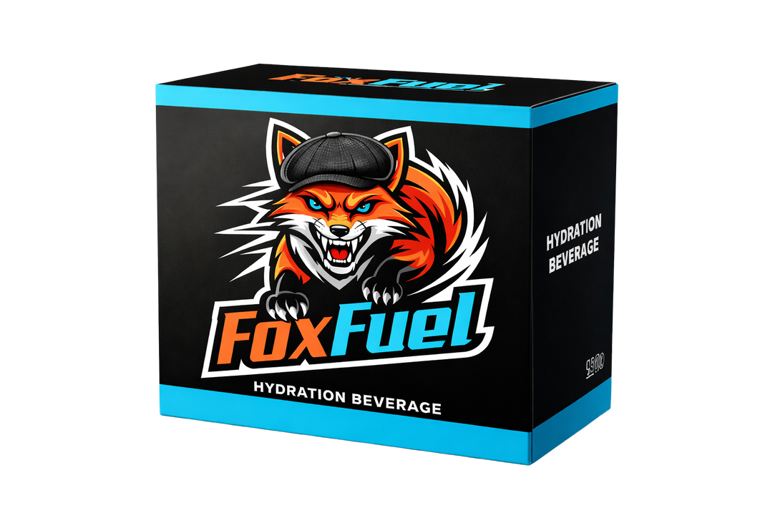
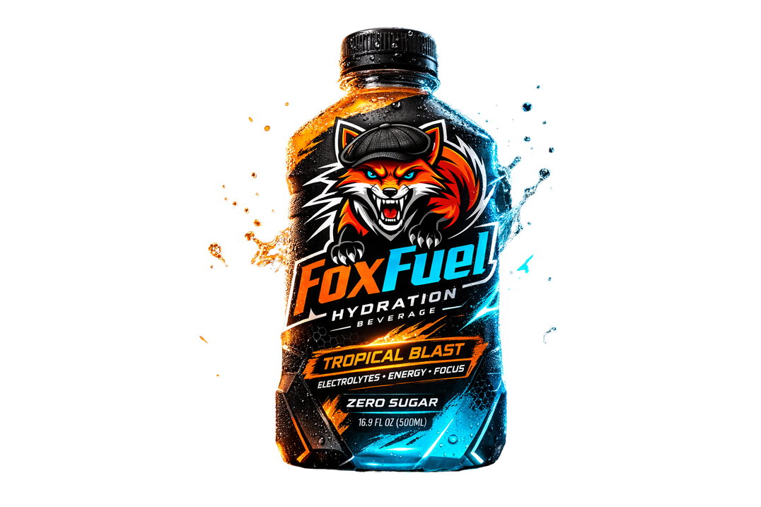
PRODUCT
Product Type.
Advanced Electrolyte Hydration
Zero Sugar
Low Calorie
Magnesium
Vitamin D
Calcium
Zinc
B Vitamins
Daily performance formula
What is it?
A premium performance zero-sugar hydration drink designed for ambitious, high-performing individuals in the business world.
Not just for workouts.
Not just for studying.
For the grind.
Why This Product?
Most hydration drinks focus on athletes.
Most energy drinks focus on stimulation.
FoxFuel sits in the middle:
Hydration + Mental Performance + Identity.
It supports:
Early mornings
Late nights
Workouts
Exams
Business meetings
Creative sessions

Slide 3
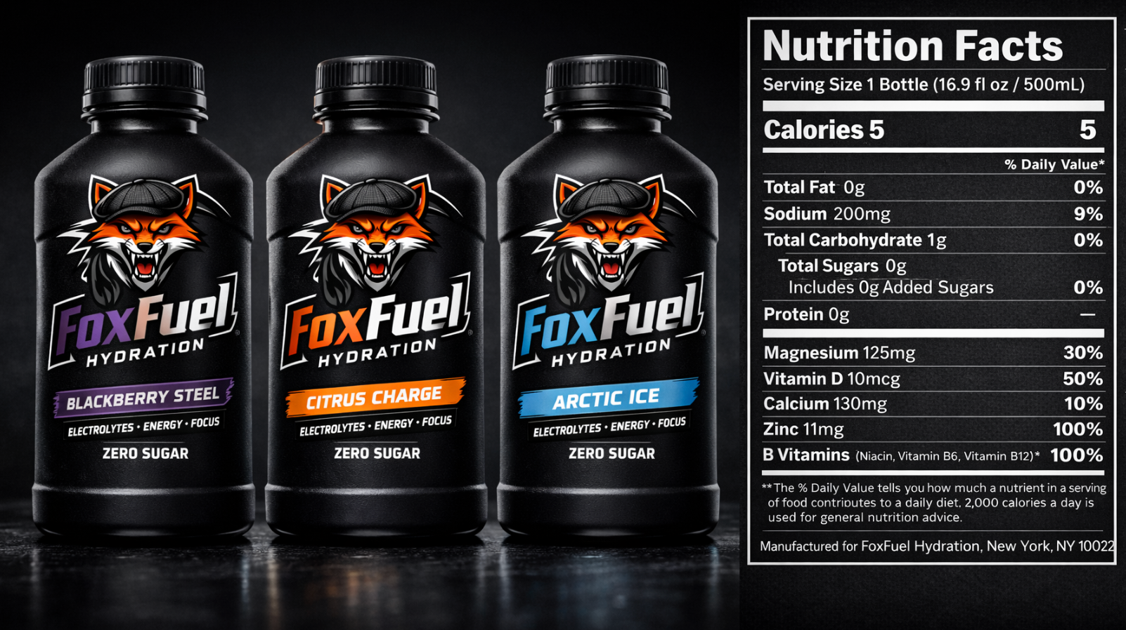
Our product

Slide 4
PRICE
Pricing Position
FoxFuel is a premium performance hydration / business drink, priced for daily use.
Not luxury. Not discount. Performance
Why This Price? (Competitive Set)
  PRIME: ~$2.50–$3.00
  CELSIUS: ~$2.50–$3.50
  Liquid I.V. (per stick): ~$1.50–$2.00
Proposed Retail Pricing
  Single 16.9oz bottle: $2.99 – $3.49
  12-Pack Case: $29.99
  Launch offer (campus): 2 for $5
FoxFuel sits slightly premium because:
  “World’s first business drink” identity
  Clean, zero sugar hydration + daily performance formula
  Strong branding + lifestyle appeal

Slide 5

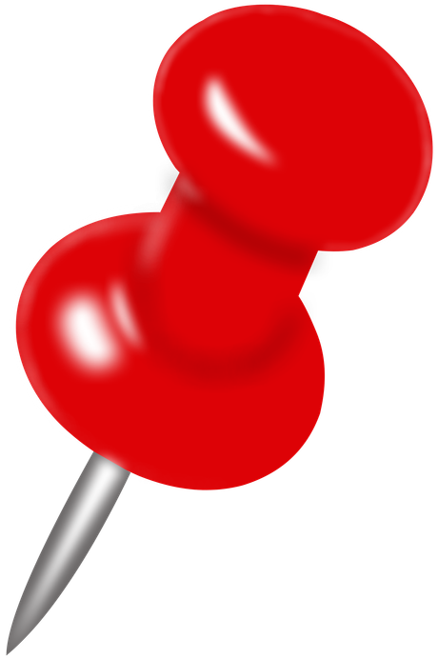

PLACE
Launch where the hustle is
Start small, achieve big.
Phase 1: Campus Domination
On-Campus Stores, Health centers, Local markets/gas stations, library vending machines, start with UMiami and surrounding campuses
Why?- Building a strong consumer base around students that also may align with the brand is the best way of making a name for ourselves prior to full-scale launch where there are already so many succesful companies

Slide 6
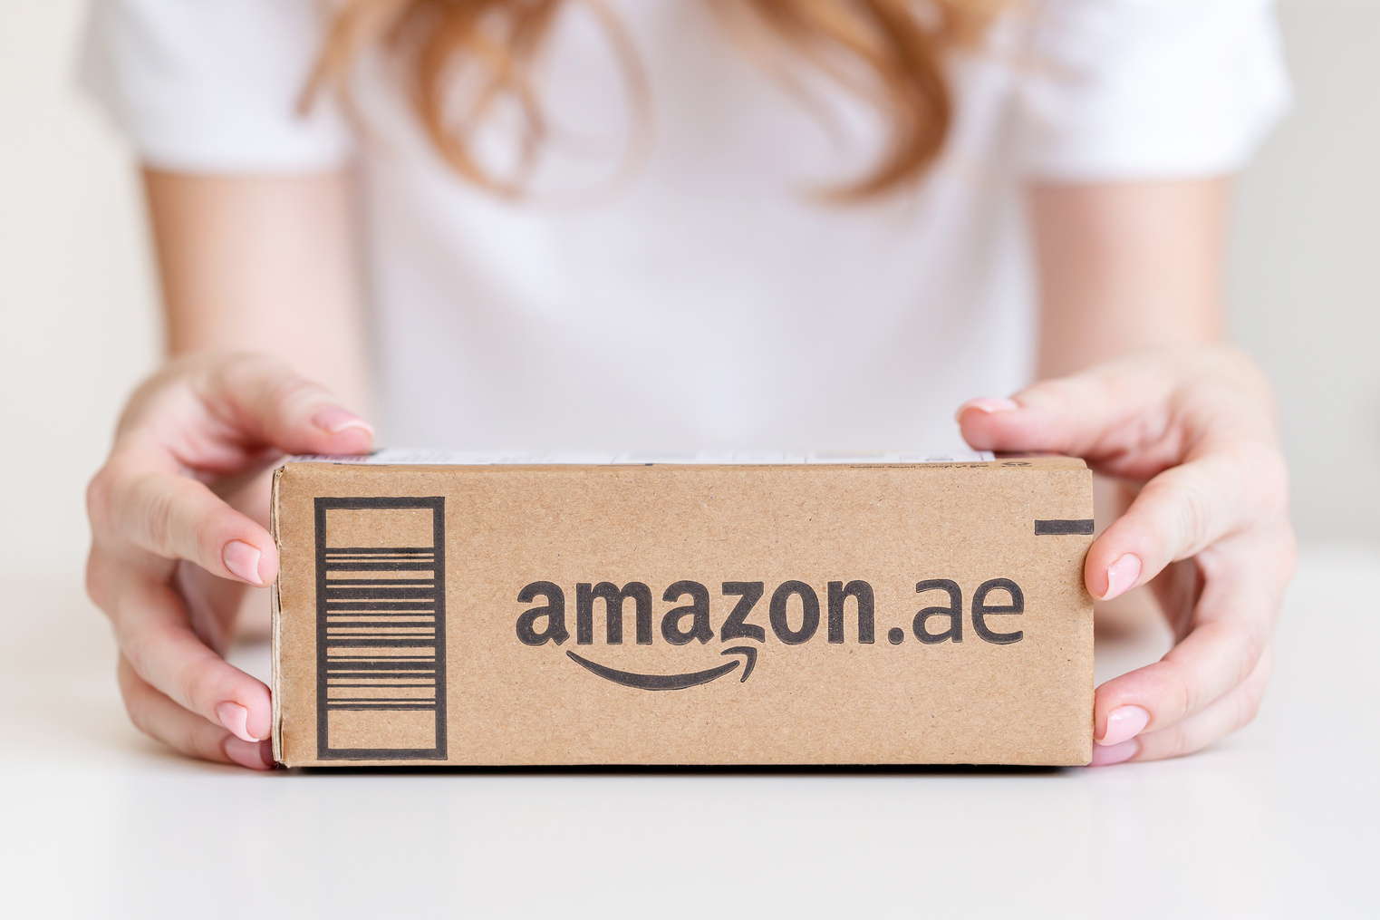

PLACE
Phase 2: Retail Expansion
Publix, Target, Amazon, Fitness chains (LA Fitness, Equinox-style gyms, Vitamin Shoppe / GNC
Goal: Once already established among students, break into the market where more people every day can access the product
Phase 3: Lifestyle Integration
Co-working spaces, Startup hubs
Boutique fitness studios, Corporate wellness programs
FoxFuel becomes the “work + workout” hydration drink.
Marketing to people in the fields of startups and entrepreneurship positions that align
with the company's message.

Slide 7



PEOPLE
What They Value
  Discipline over motivation
  Consistency over hype
  Long-term success
  Fitness + focus
  Personal growth
  Identity driven brands
They don’t just consume products.
They consume the brand identity.
A&P is built for individuals who are actively building their future.
Primary Target
Age: 18–30
Location: College campuses and active cities
Lifestyle: Business + productivity driven
Core:
College students, CEOs, Entrepreneurs/founders, Athletes with a strong personal brand, Business majors.

Slide 8
MARKETING
Most companies in the drink industry are marketing caffeine-based drinks or hydration drinks
to athletes or lifters who only practice lets say, 10-15 hours a week. Where we differ is that an average 9-5 or CEO works a full 40-hour + overtime a week. Almost saying we could market the product for fuel for 50 hours, not 2.
The beverage will have vitamins such as Magnesium, Calcium, Potassium, and other essential vitamins so that
people with long hours and busy schedules may not fully take advantage of it throughout the work week.
This would show up in stores as a full source hydration and vitamin-rich beverage providing everything you need to stay efficient throughout the work week
We would start buy giving free samples to business proffesors and local business in big cities in order to get our name out

Slide 9
PROMOTION
Aspire. Persevere. Always.
World First Business Drink.
Our postion: The drink for disciplined achievers.
Not hype. Not party.
Structured performance.
Since the market is flooded with companies who advertise to athletes,
Our primary focus is on those grunts and grinders who are
in the business field or work a job that requires tireless effort.
It’s a unique concept that you never see, therefore an untapped market.
This is the beverage for:
  Early risers
  Builders
  Founders
  Students grinding
  High standard individuals

Slide 10



PROMOTION
How to Market?
Position the beverage as a symbol of:
Resilience, Discipline, and Relentless growth
Partner with local successful companies and gyms
such as CalAI, Anatomy Fitness, and Equinox. But keep it to high-standard partnerships. This includes D1 athletes, Startup founders, High-level CEOs, and High-performing students. Each partner should embody “Apire. Perservere. Always.”
Cinematic videos of real struggle to success stories (athletes, entrepreneurs, CEOs)
Distribution: Social Media Marketing, Instagram Reels, TikTok, YouTube Shorts
Provide free samples to offices
and schools to promote the
business and grind audience

Slide 11
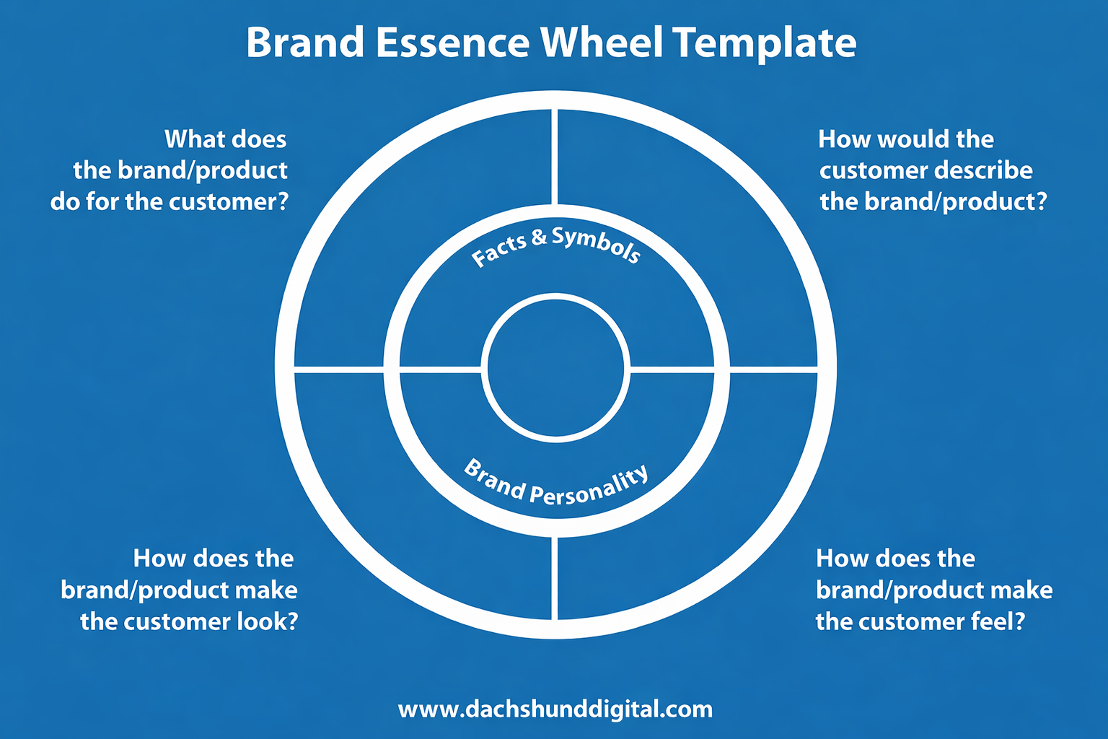
Hydrating
Fueling
Focus
Relentless
High-performing
Clean
Fox logo
Stamina
Built for business
Supportive
Zero sugar
Driven
Vitamin Rich
Ferocious look
Driven
Structured
Focused
Aspire And Persevere
Always.
Professional
Reliable
Confident
Competitive
Motivated
Relentless
Disciplined
Ahead of schedule
Ambitious
Structured
Locked in
Ready to execute
Competitive

Slide 12

BRAND ARCHETYPE
FoxFuel supports high performers who:
  Clock in when others don’t
  Push through long days (work, class, gym)
  Stay consistent, not just motivated
  Compete with themselves every day
FoxFuel = The Hero
The Hero is driven by:
  Achievement
  Courage under pressure
  Discipline and self mastery
  Proving what’s possible through effort

Slide 13
BRAND ARCHETYPE
How “Hero” Shows Up in the Brand
Visuals
Bold fox logo = smart + relentless + fierce
Displaying serious performance
Direct, Confident, No excuses
Messaging
“Fuel for the relentless.”
“Not just for workouts.
Not just for studying.
For the grind.”

Slide 14

Who am I?
I am built on ambition, discipline, and execution. I chase progress and know you first have to fail to suceed
I have been very entrepreneurial and competitive from a young age
I strive to create and maximize the potential for everything I start in my life, and I embrace challenges and welcome uncomftorability
Why This Drink Fits Me
FoxFuel isn’t just hydration.
It represents how I operate:
  Aspire → Think bigger
  Persevere → Outlast obstacles
  Always → Show up daily

